Slide 1
32a – Clean Code – Singleton and Monostate Patterns
Based on the CleanCoders videos by Uncle Bob Martin
Rupert Waldron

Slide 2
Singleton Pattern
Singleton pattern is great when you only want one of an instance like a ServiceRegistry
If you just want one, only create one… easy
What about other programmers… what about if you have written a public API, what is to stop other developers creating more than one instance

Slide 3
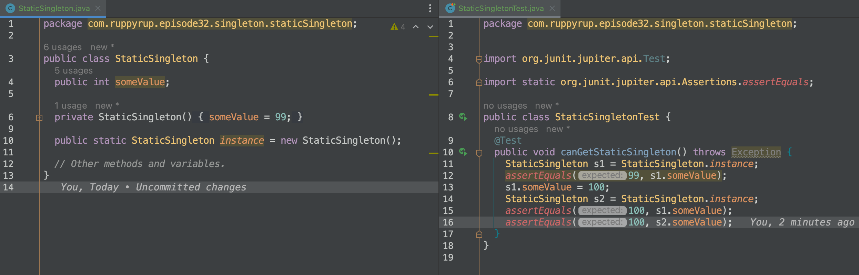
Static Singleton
note the constructor is private so you can’t instantiate the class under normal circumstances
new StaticSingleton() is only called once because it is static
StaticSingleton.instance is static so belongs to the class rather than the instance – only gets created once

Slide 4
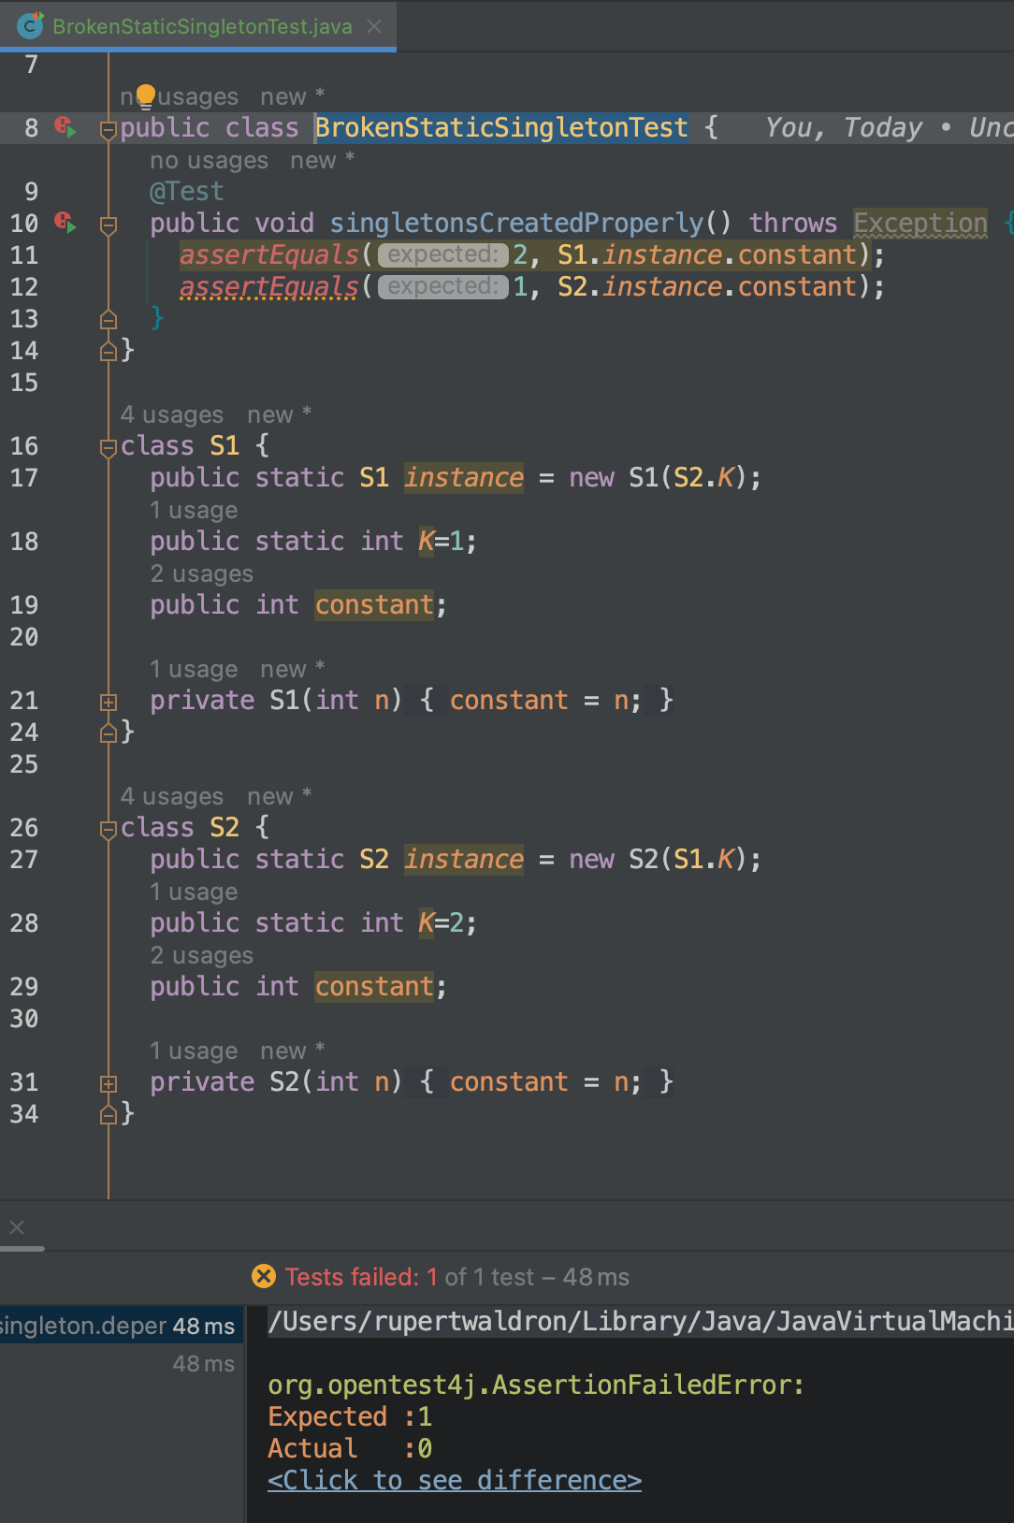
Static Singleton - Broken
S1 depends upon S2.K and S2 depends upon S1.K – which order should they get initialized in?
No correct order of initialization. Hence the failure.
No compiler warnings or helpful advice from Intellij.
This is the same for the enum singleton

Slide 5
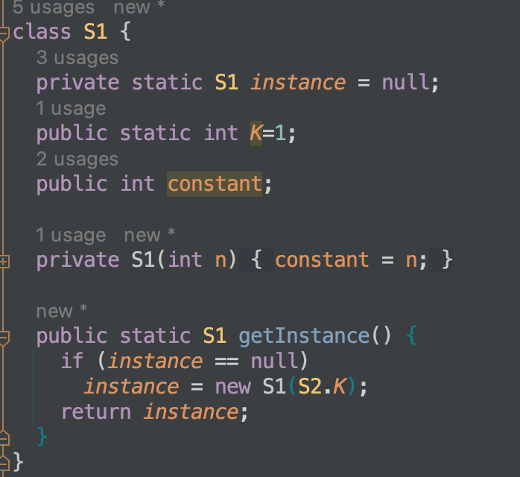
Dynamic Singleton
Instance variable is now private
The constructor is still private
The instance is initialized only when it is called. Subsequent calls to getInstance() will just return the same instance.
This fixes the problem of the static singleton… but what about threads?

Slide 6
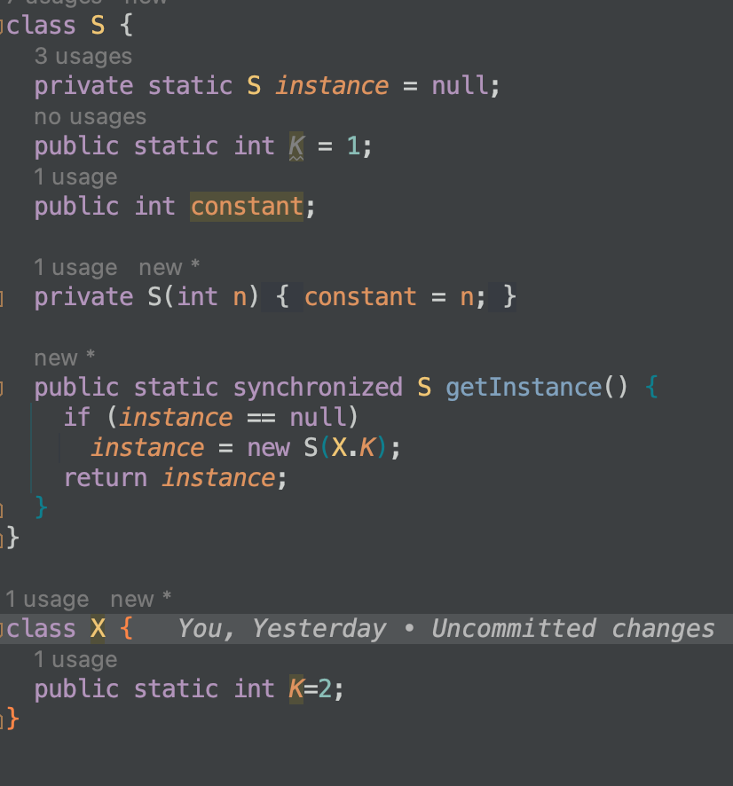
Dynamic Singleton and Threads
Look at the test – 2 instances are created when 2 or threads request getInstance() at the same time
Make the getInstance() synchronized so only one thread can enter at a time.
But how fast is it… look at the test
257ms vs 3ms for 10_000_000 iterations.

Slide 7
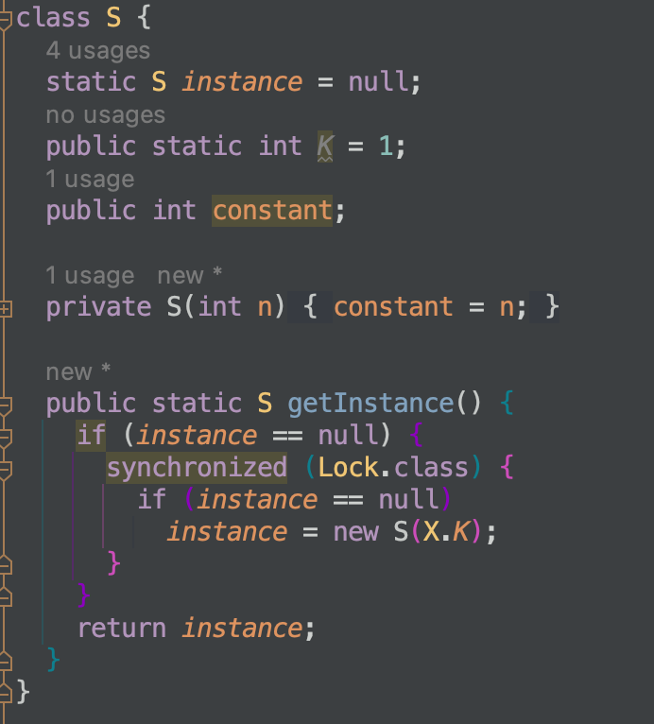
Dynamic Singleton double check Lock
Check if the lock is taken before synchronizing
But how fast is it… look at the test
6ms vs 257ms for 10_000_000 iterations.
Step 1
But… there is a tiny problem… In Java the compile is allowed to reorder the write assignments is it could actually perform step 2 before step 1. Leading to instance pointing to uninitialized memory.
Step 2

Slide 8
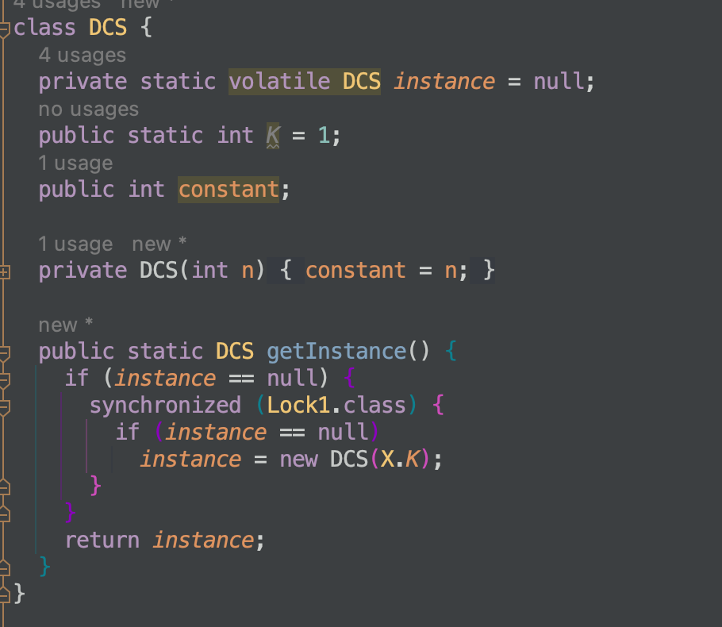
Dynamic Singleton double check Lock - Volatile
Use volatile keyword to stop the compiler from re-ordering the assignment statements
Volatile makes any data changes visible to all threads

Slide 9
When to use which Singleton Method
No API: Just create 1
API but no cycles: static initializer
API + Cycles: Dynamic singleton
API + Cycles + Threads : Lock
API + Cycles + Threads + Time critical: Double checked lock of volatile variable.

Slide 10
Monostate Pattern
Singleton pattern is great when you only want one of an instance like a ServiceRegistry
Monostate Pattern is good if you only want one of an instance but you don’t want anyone else to know it is only one instance.

Slide 11
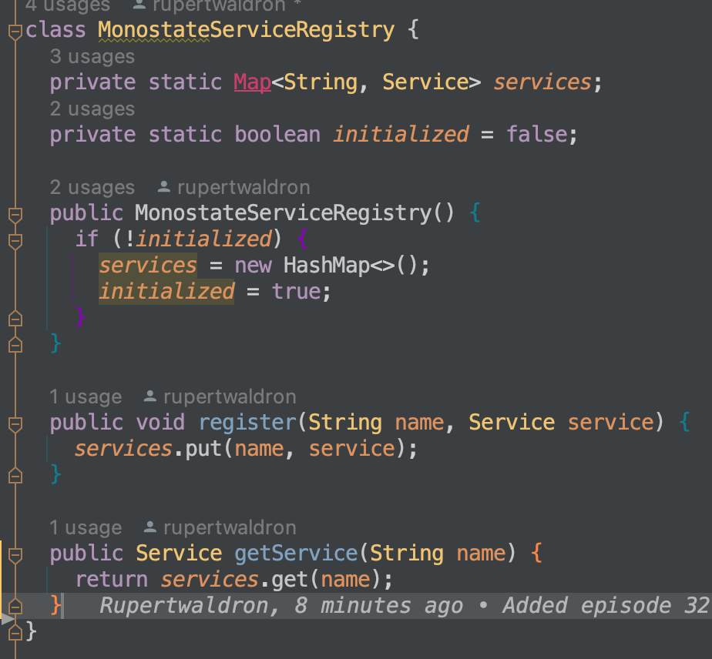
Monostate Pattern
Monostate pattern uses a public constructor so you can create many instances, but all the variables are held in a static map – see the code.
The state remains after all the instances have been destroyed – ready for the next instance to be created
You can also create derivatives of the monostate class and have different policies for controlling the same information.

